Slide 1


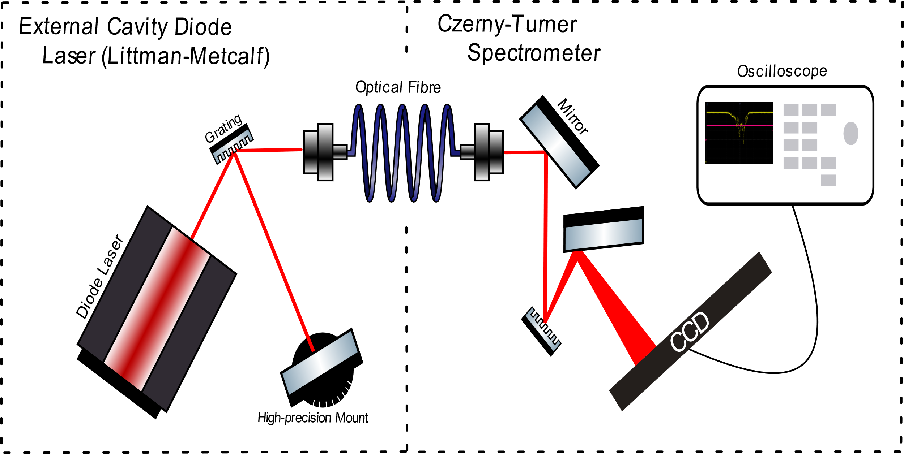
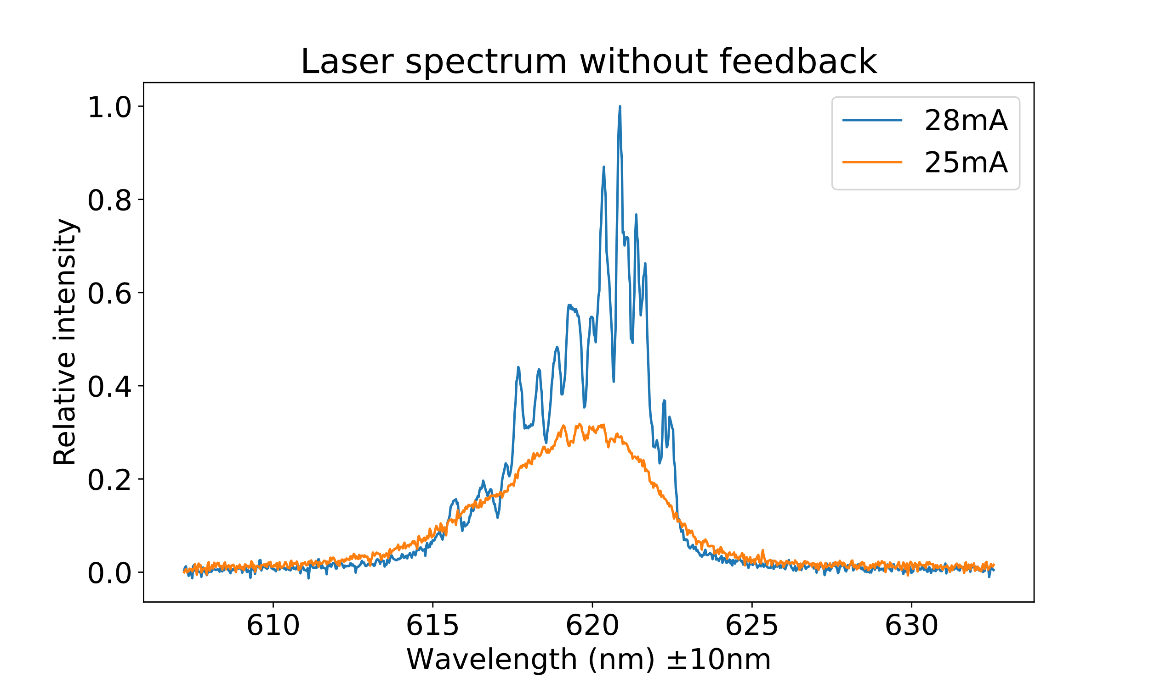
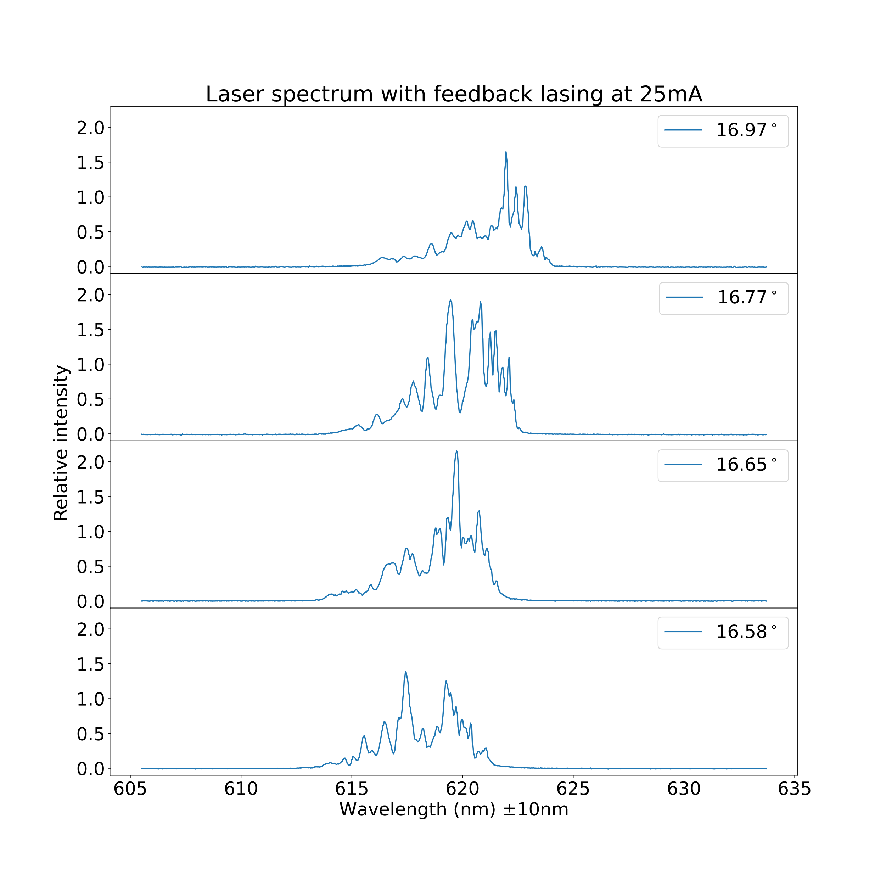
Measuring the Effect of Optical Feedback on a Diode Laser
T. de Boer, R. van Straaten, E. Zegers
1. Introduction
2. Theory
Optical feedback is the phenomenon in which a selected mode of a diode laser is reflected back into the laser cavity to amplify it. For this project we built our own External Cavity Diode Laser (ECDL) and Czerny-Turner Spectrometer to measure this effect.
3. Methodology
The ECDL makes use of a Littman-Metcalf configuration, where a mirror mounted on a high-precision rotation stage selects which wavelength(s) are feedbacked into the diode laser [2]. The zeroth order diffraction of the ECDL is directed into a spectrometer, which displays the wavelengths present in the beam. The spectrometer is calibrated with a neon lamp.
4. Results
Figure 1: Schematic drawing of the setup used in the experiment. On the left is the External Cavity Diode Laser (ECDL) in a Littman-Metcalf setup. On the right side a Czerny-Turner spectrometer.
Figure 3: Spectrum of the diode laser at 25mA (orange) and at 28mA (blue). The intensity is normalized by the highest peak at 28mA.
5. Conclusion
When the laser was provided with optical feedback, the laser’s spectrum narrowed and shifted. The shift was dependent on the laser mode reflected back into the laser cavity. The wavelengths which provided the most obvious shifts and narrowest peaks when providing feedback correspond to the wavelengths of the peaks shown in the broad spectrum of Figure 1.
6. Discussion
We had trouble calibrating the spectrometer due to the neon light not providing a sharp spectrum. This caused our measurement wavelengths to have a large error on them. We attributed the many peaks of the diode laser to the cavity which is inside the laser itself. This cavity allows only the standing waves that fit in the cavity to be emitted.
7. References
[1] Jumpertz, L. (2017). Optical Feedback in Interband Lasers. In: Nonlinear Photonics in Mid-infrared Quantum Cascade Lasers. Springer Theses. Springer, Cham.
[2] Erik G. Brekke, Matthew A. Schulz; Observation of laser feedback using a grating spectrometer. American Journal of Physics 1 July 2015; 83 (7): 616–620.
Figure 4: Spectra of the diode laser with optical feedback. A laser mode (wavelength) is selected by changing the incidence angle normal to the diffraction grating (see labels). The result is an enhanced peak at the wavelength providing the feedback. The intensity is relative to the highest peak of the laser at 28mA without feedback.

